Slide 1

加密货币技术沙龙

Slide 2
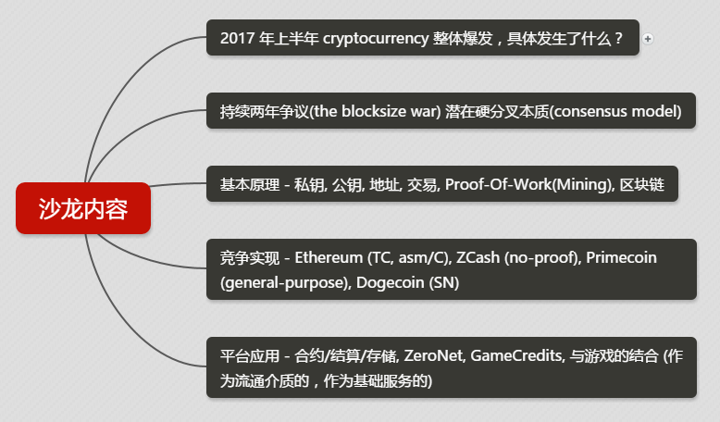

Slide 3
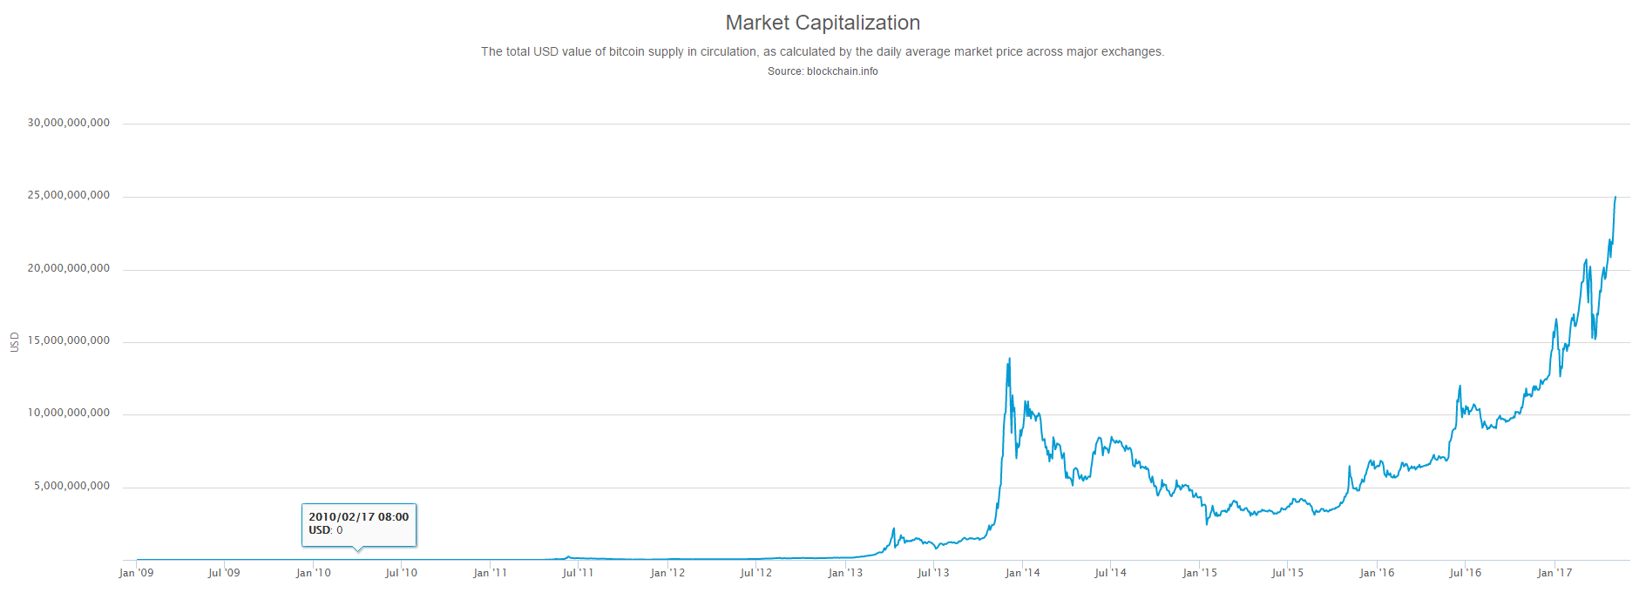
cap (2009.01 - 2017.05)

Slide 4
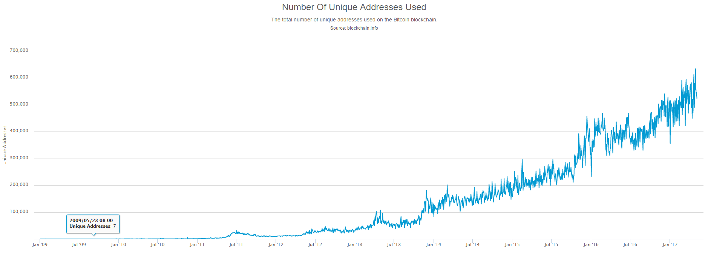
活跃地址数 (2009.01 - 2017.05)

Slide 5
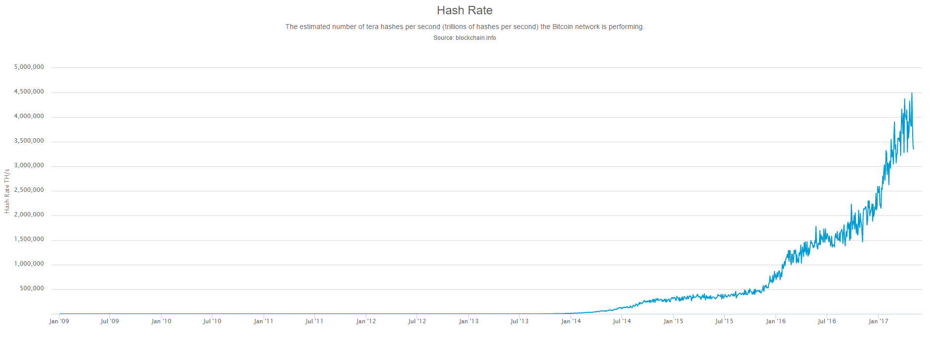
算力 hashrate (2009.01 - 2017.05)

Slide 6
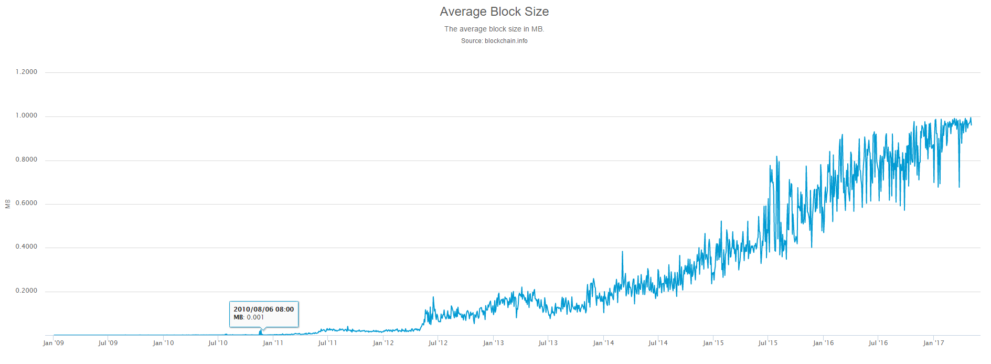
blocksize (2009.01 - 2017.05)

Slide 7

What is Bitcoin
Blockchain.com

Slide 8
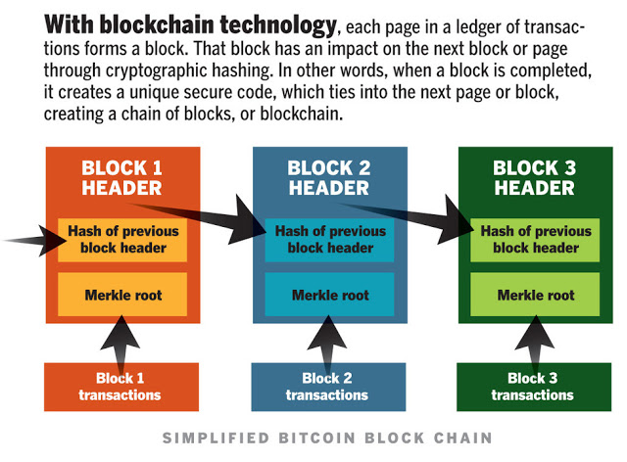
Blockchain (1)

Slide 9

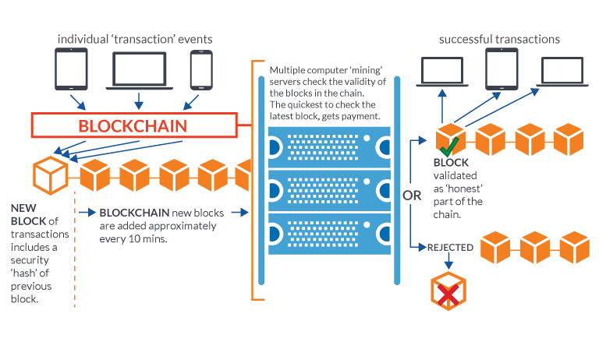
Blockchain (2)

Slide 10
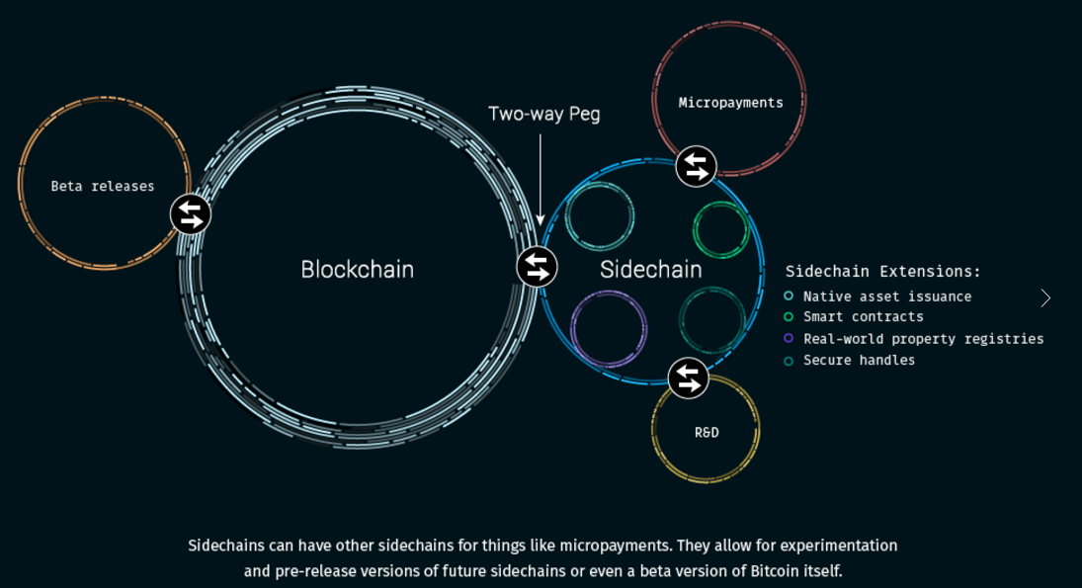
sidechain

